Slide 1
Cross-Platform Mobile Applications Development
B.Sc. Web Technologies & Programming
Department of Computer Science & Applied Physics

Slide 2
Model View Controller MVC
Model – Represents the data
View – Displays the data
Controller – Controls interactions between View and Model

Slide 3
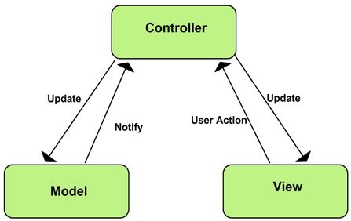
MVC

Slide 4
MVC Benefits
Separation of Concerns
UI is separated from Business Logic which is separated from Data
Reusability
Code not tightly coupled
Multiple Views of same Model
Easier Testing
Data model can be tested without any UI e.g. database structure
UI can be tested without full access to model
Business Logic can be tested with or without UI,
or with or without Model

Slide 5
MVC Drawbacks
Complex
Extra layers of indirection
(Indirection is the ability to reference something using a name, reference, or container instead of the value itself)
Can have performance issues due to layers of indirection

